Slide 1
Why we need more readers in the world
Notes:
I recently listened to a talk by speed reading and brain performance expert Jim Kwik about the benefits of reading. His talk really sat with me. It got me thinking how we’re always trying to tackle the world biggest problems like climate change or gender equality which is all very noble, so I thought, why not start somewhere small and manageable.
Why don’t we change the world one book at a time?
Why don’t we have more readers in the world to inspire and bring change?

Slide 2
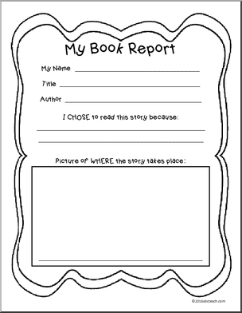
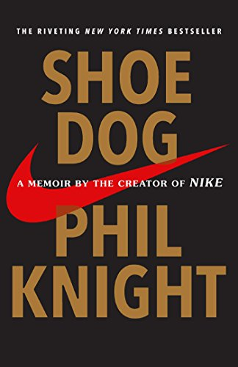
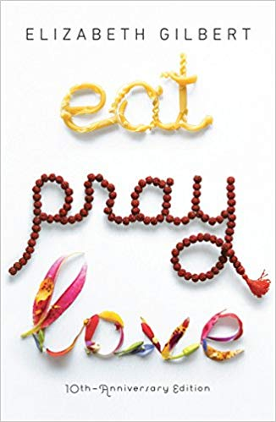
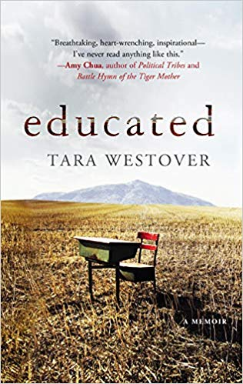
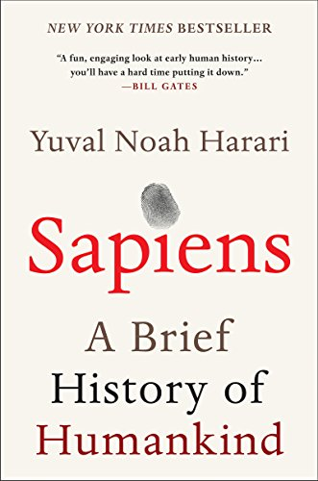
Notes:
In elementary school, we used to write these things called book reports. Basically, they were summaries of books you read. Looked something like this. And at that time, reading was cool, so I was consuming books like a kid in a candy store. Sadly, somewhere between elementary school to the busy-ness of being a university student to becoming a full-time working adult, I lost my passion for reading.
A book would become a hypnotist, and every time I would pick one up I would fall asleep or start scrolling through my Instagram feed or respond to another group text.
Last year, I met an author that changed my life. I was fascinated by him, the wisdom he carries and the questions he would ask. But mostly I was hooked onto his reading habit. He had a goal of reading 52 books a year – that’s q book a week. I only read 7 books last year – yup pretty disappointing.
After meeting this author I was determined to do better, I set a goal in 2019 of reading 20 books. I am currently at book 19. Some books have changed how I think, some books have inspired me to do something, and other books have pushed me on a journey of self-exploration. But I’ll tell you more about that at the end
I'm here today because I’m excited to share with you the benefits of reading. I want you to know all the wonders it can bring if you just have a little patience and concentration to get to know the story.

Slide 3
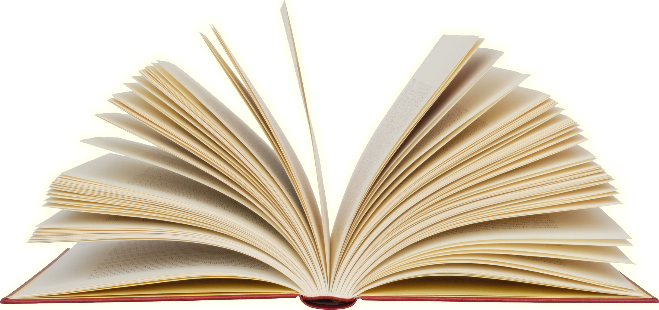
How will reading
benefit me?
Notes:
1. Strengthen your mind
2. Make you a better storyteller
3. Make you a better person

Slide 4
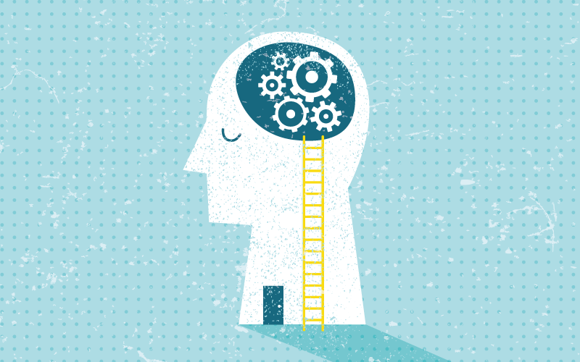
Improve brain health and mental health
Reading….
Reduces stress
Decreases mental decline
Is brain food
Notes:
REDUCES STRESS
In a study at the University of Sussex, they found that reading only for 6 minutes will already slow down your heart rate and relax your muscles. Reading before bed is said to put your brain in a relaxed state and help you to fall asleep easily. In a study at the
DECREASES MENTAL DECLINE
study showed that depressed patients that were read stories aloudshowed positive improvement in their mental health
IS BRAIN FOOD
When you read you have to remember many characters, plots, lessons etc. In this process new synapses/neural pathways are being created and strengthened therefore memory and recall abilities are improved
In a study participants read 30 pages of a book and had their brains scanned the next morning. Results showed increased connectivity in left temporal cortex - associated with language and intelligence. Literally stories stay with us.

Slide 5
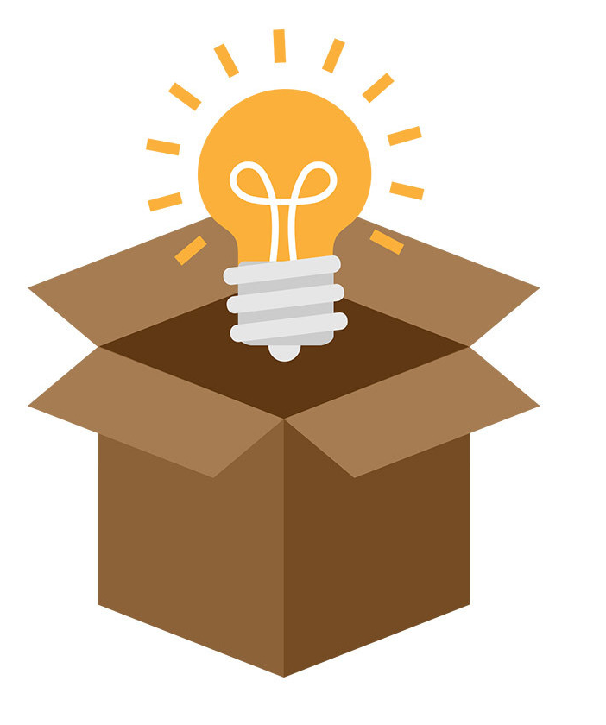
Level up your Storytelling skills
Reading…
Improves writing
Nurtures your creativity
Inspires
Notes:
IMPROVES WRITING
When you read you subconsciously absorb good writing structure, expand your vocabulary, you see what a good story looks like and that translates to your writing
NURTURES YOUR CREATIVITY
Neuroscientists at Emory University * found that reading fiction could improve the reader's imagination in a way that is similar to muscle memory** in sports
READING INSPIRES
Ideas, concepts, adventures, lessons, emotions. Takes you to a different world and can refresh your mind
https://thatistheday.com/reading-will-inspire-creativity/

Slide 6
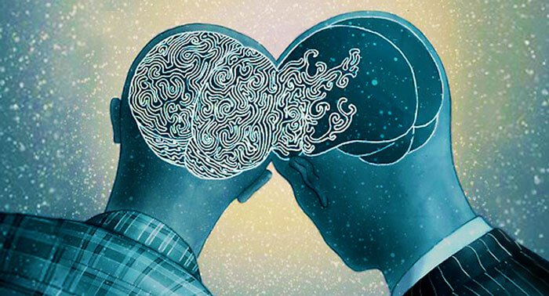
Become more Empathetic
Reading …
Improves Theory of Mind
Notes:
One huge benefit of reading fiction especially is the ability to put yourself in someone else’s shoes.
Theory of mind – understanding that people have mental states different from your own i.e.beliefs, knowledge, emotions
The pen experiment
Popular research method where you “accidentally” drop a bunch of pens on the floor and then see who offers to help you gather them up. Before the pen-drop took place participants were given a mood questionnaire with some questions measuring empathy. Then they read a short story and answered a series of questions about how much the story emotionally moved them
The results: the people who felt the most transported by the story and expressed the most empathy for the characters were more likely to help retrieve the pens.
Taking into account the people’s scores for empathy and researchers found that, regardless, those who were most transported by the story behaved more kindly.
https://www.bbc.com/future/article/20190523-does-reading-fiction-make-us-better-people

Slide 7
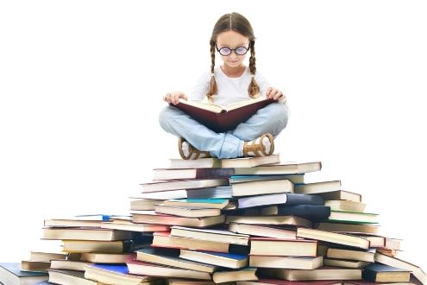
In conclusion…
Read to…
Build a stronger mind
Be a better storyteller
Be a better person
Notes:
In all honesty, not because I’m trying to prove my own point, I truly believe that reading strengthens your mind, makes you a better storyteller, and an overall better more understanding person.
And now looking back at these books I read this year, they have become my biggest inspirations, teachers and companions. Researchers have found that those who read about characters doing something are more likely to do that activity IRL.
Remember when I told you about earlier and what books did for me?
Sapiens taught me the importance of knowledge and ignorance and how our storytelling has created society and cultures and how we literally need each other to cooperate and survive.
The creator of Nike, Phil Knight, in Shoe Dog taught me that we grow or we die and the most important race you will run is against yourself. I’ve been inspired to run the 10k that I’ll be running in 2 weeks time.
Elizabeth Gilbert in Eat Pray Love taught me about the courage to embark on a personal journey to find yourself – I solo travelled for the first time last month and travelled to 9 countries in 3 weeks.
I’d like to finish off with a quote from popular show, Game of Thrones.
He goes" A reader lives a thousand lives before [they] die. The man who never reads lives only one “

